Slide 1
STOCK PRICE PREDICTION

Slide 2
CONTENT
Deep Learning
Deep Learning Necessity
Tesla Stock Price Dataset
Algorithm
Conclusion
References

Slide 3
ABSTRACT
Demand of Stock have become huge with Increased in popularity of Stock in Digital world. Prediction and Analysing stock can benefit People to think before buying or selling stocks. So, A New Stock Price Prediction through Deep Learning Algorithms has been analyzed and visualized. Through This System we can predict of any Company stock in the world.

Slide 4
DEEP LEARNING
Deep learning is a specialized AI technique that replicates the neural processes of the human brain for data analysis and pattern recognition.
It falls under machine learning, utilizing deep neural networks to autonomously learn from unstructured or unlabeled data.
These deep neural networks are highly effective in clustering data and making precise predictions, using multiple processing layers to enhance their learning ability.
Although deep learning systems are powerful, they still fall short of matching the complexity and capability of the human brain.

Slide 5
DEEP LEARNING NECESSITY
Deep learning has advanced alongside the digital era, which has led to a massive surge in data generation across various domains globally. This data, often referred to as "big data," originates from diverse sources such as social media platforms, search engines, e-commerce sites, and online streaming services.
The vast volume of data is now more accessible and can be efficiently distributed through cloud computing technologies.
Despite its accessibility, the data is largely unstructured and voluminous, making it challenging for traditional data processing methods to analyze and derive meaningful insights within a reasonable time frame. To harness the potential of this data, organizations are increasingly turning to AI-driven deep learning models, which are capable of processing and interpreting large-scale datasets, thereby automating and enhancing decision-making processes.

Slide 6
GOOGLE STOCK PRICE DATASET
Tesla, Inc. is an American multinational automotive and clean energy company that specializes in electric vehicles, energy storage solutions, and solar energy products. The company is recognized as a leader in the electric vehicle market and has significantly influenced the global shift towards sustainable energy.
Tesla is listed on the NASDAQ stock exchange under the ticker symbol TSLA.
The dataset spans from 28-08-2023 to 23-08-2024.

Slide 7
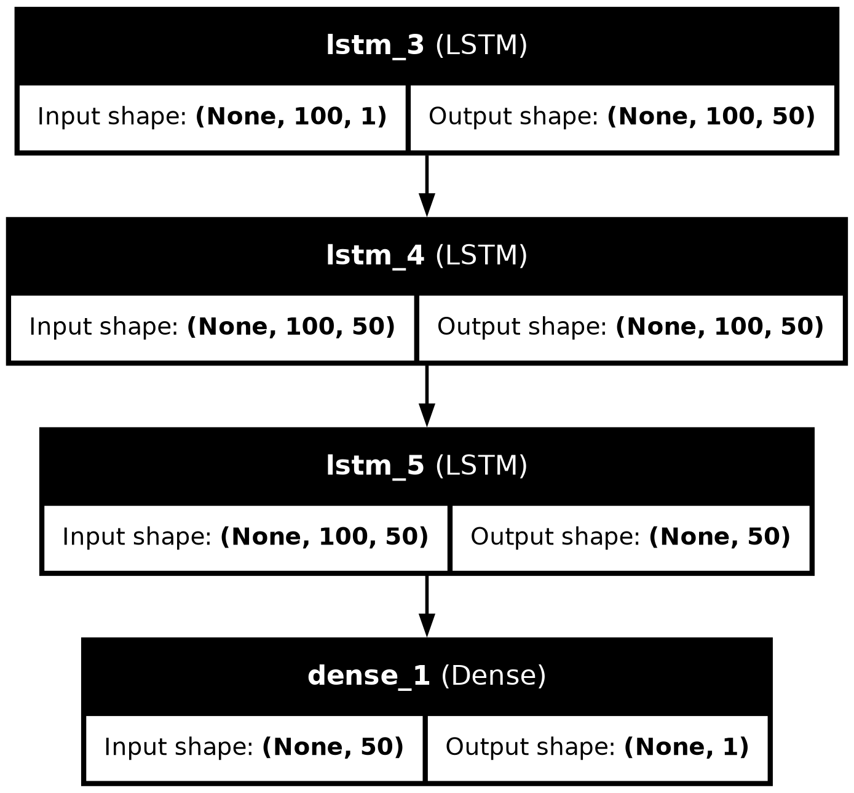
Algorithm: Enhanced LSTM Model Training for Stock Price Prediction

Slide 8
CONCLUSION
The model constructed is an LSTM-based neural network designed to forecast Tesla stock prices.
It leverages three LSTM layers to capture temporal dependencies in the data and a Dense layer to produce the final predictions.
The model is configured to handle sequences with a time step of 50, optimizing performance with the Adam optimizer and mean squared error loss function.

Slide 9
REFRENCES
https://machinelearningmastery.com/start-here/#getstarted
https://colah.github.io/posts/2015-08-Understanding-LSTMs/
https://www.sas.com/en_us/insights/analytics/machine-learning.html
https://groww.in/us-stocks/googl
https://www.investopedia.com/terms/d/deep-learning.asp
https://www.nasdaq.com/market-activity/stocks/goog

